Slide 1
This is Loudwater Combined School.

Slide 2
This is the pathway which leads to the Foundation Stage Play Area.

Slide 3
Outdoor Play Area Children can choose an activity in the outdoor area.

Slide 4
The Foundation Stage Classroom This is where the children come into the classroom. I wonder who we might find inside?

Slide 5
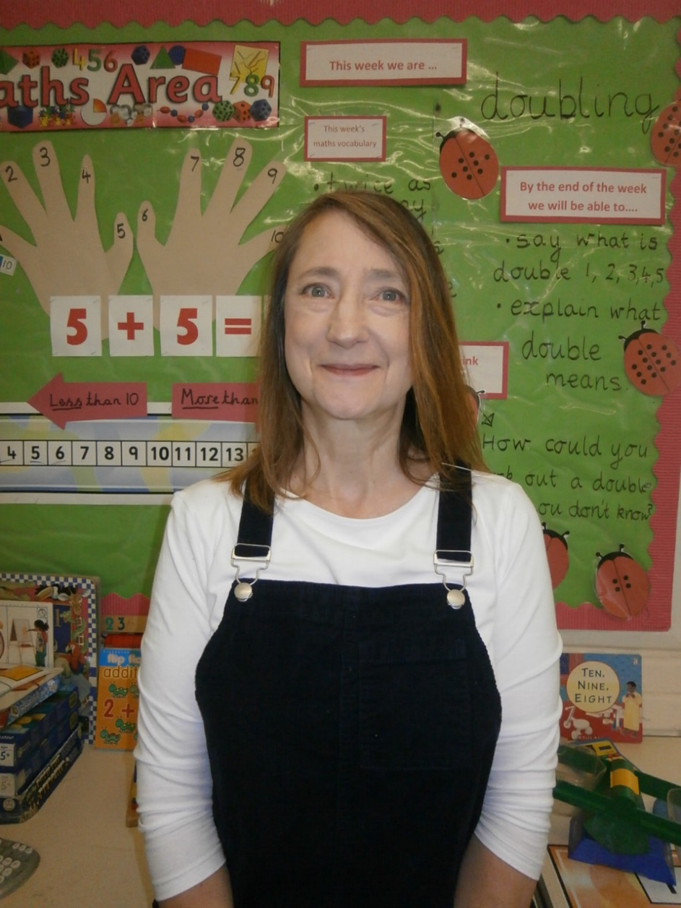
This is Miss Harris. She is the teacher for Foundation Stage.

Slide 6
Mrs Greenaway and Mrs Williams are the teaching assistants who work in Foundation Stage.

Slide 7
The Cloakroom This is where the children hang up their coats and keep their PE bags.

Slide 8
The toilets are next to the cloakroom . These are only used by the children in the Foundation Stage Class

Slide 9
Children can build using the wooden blocks – What would you like to make?

Slide 10
This is our amazing ‘bug carpet’. This is where we sit in the morning when we come into class.

Slide 11
Building in the outdoor area.

Slide 12
Making models using play-dough.

Slide 13
The house often changes to become a different area.

Slide 14
The School Hall This is where the children come for Assembly, PE and to eat their lunch.

Slide 15
Lunchtime in the hall.

Slide 16
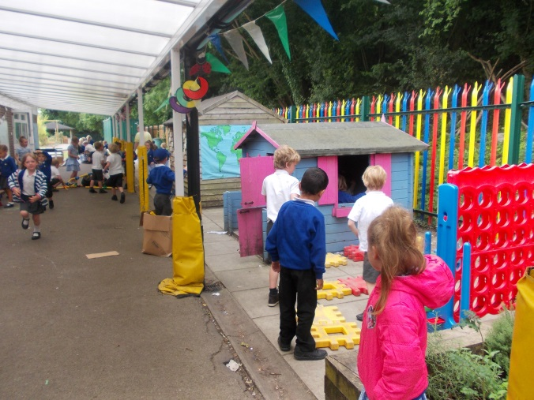
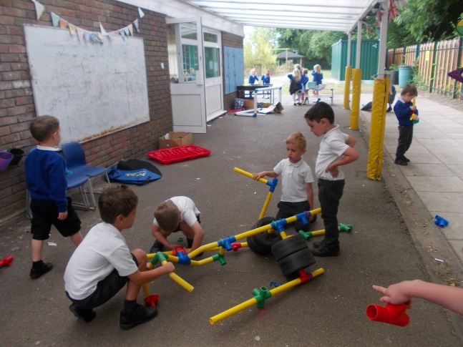
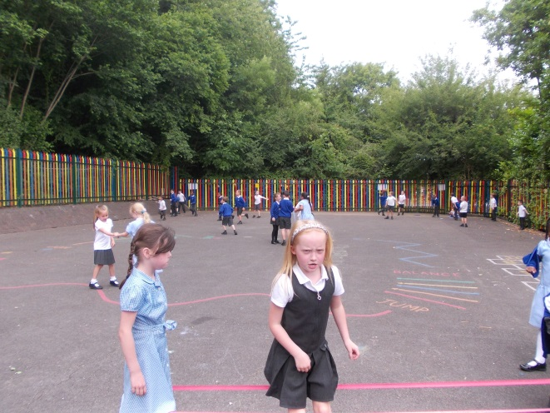
The Key Stage One Playground This is where the Foundation Stage, Year 1 and Year 2 children play during the morning break and afternoon break.

Slide 17
Every class has a turn to play on the Web Explorer.

