Slide 1
WELCOME TO YEAR 5
Mrs Pierce Collinao (Mrs PC)
Mrs Lane – Class Teaching Assistant
Miss Olcot– Learning Support Assistant

Slide 2
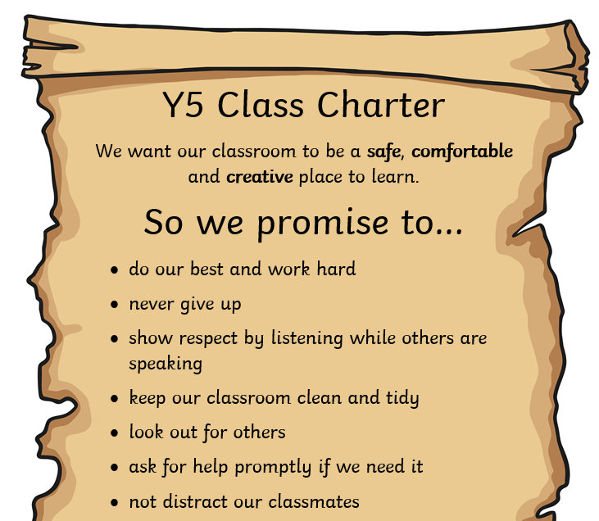

Our Class Charter, written and signed by the children
House Points!

Slide 3
Reflective Learning Time – Break & Lunch
This is linked to our behaviour policy and pupils who receive an orange or red sanction will be asked to complete a reflection sheet and miss 10/15/30 minutes of their break time.
Occasionally, pupils will be asked to rewrite or finish off work that they were expected to complete in a lesson.
This involves going to the Duty Teacher’s classroom and completing the work before going out to play/eat.

Slide 4


Home Learning
Maths home learning is set on a Thursday and will be checked the following Thursday:
60 minutes of Maths Whizz (this includes in-school Maths ICT slot time)
TTRS log-ins will work up until Year 6 – this is optional but recommended!
Reading Bookmark & purple Reading Journal checked weekly (pupils know which day they need to hand this in). Journals should be in school EVERY DAY as we sometimes complete an activity in class.
Minimum of 2 high-quality Reading Journal entries per half term
If Maths or Reading home-learning tasks are not completed then pupils will be expected to complete this during Thursday lunchtime.

Slide 5
Home Learning
There may be a creative project to complete linked to our Topic or Science lessons (you’ll get plenty of warning - at least 3 weeks!).
I may also set an optional home-learning task but will not formally record completion of this.
If any pupil has any problems completing or understanding the home learning tasks set they should come and speak to me as soon as possible.

Slide 6

Reading Journals – Purple A5 books
• Regular reading is crucial to improving both fluency and comprehension
• Reading is a vital part of becoming a better writer
• Quality of reading books – please see Y5 recommendations / Reading book / Library book
• Selection of activities to do in the first few pages
READING JOURNALS NEED TO BE IN SCHOOL EVERYDAY

Slide 7
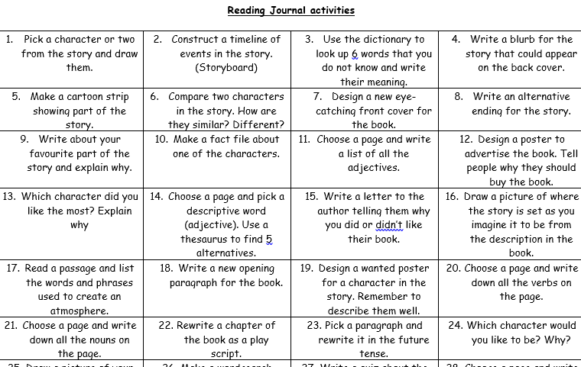
There are plenty of activities to choose from!

Slide 8
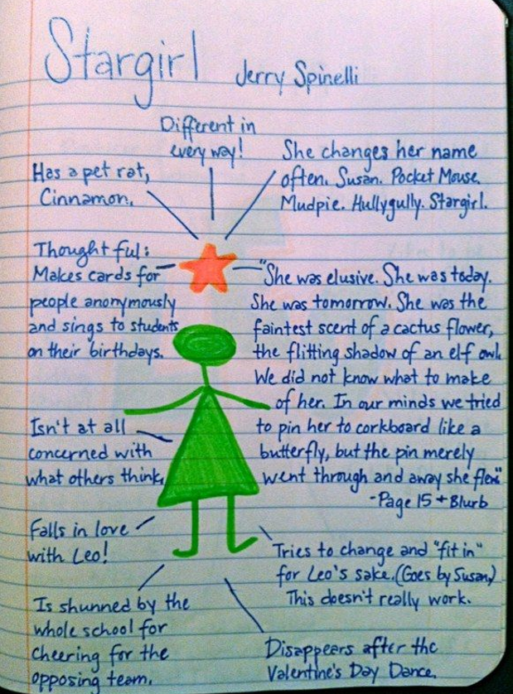

Possible texts to read
Recipes
Instructions for a Lego model
An article from a magazine, newspaper or online journal
School reading book
Library book
Any book or text at home

Slide 9
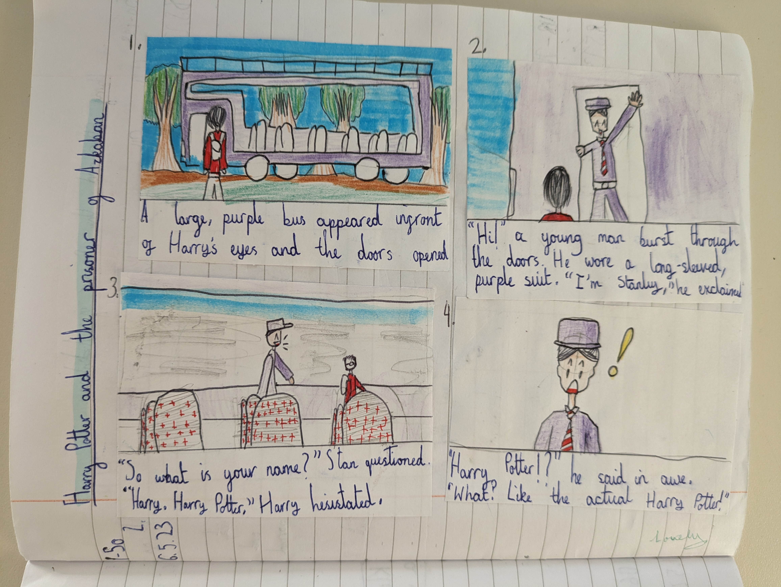

Slide 10
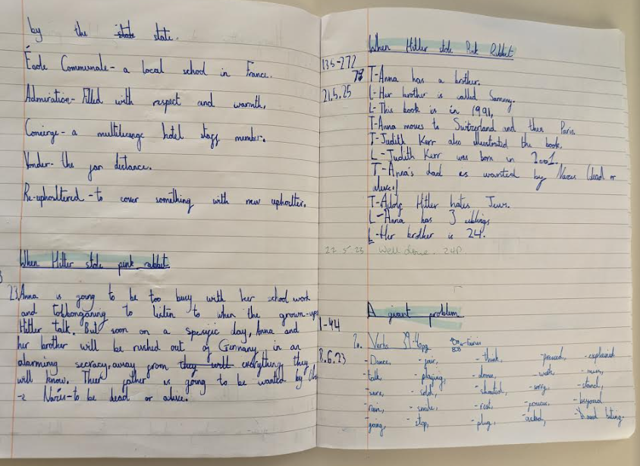

Slide 11
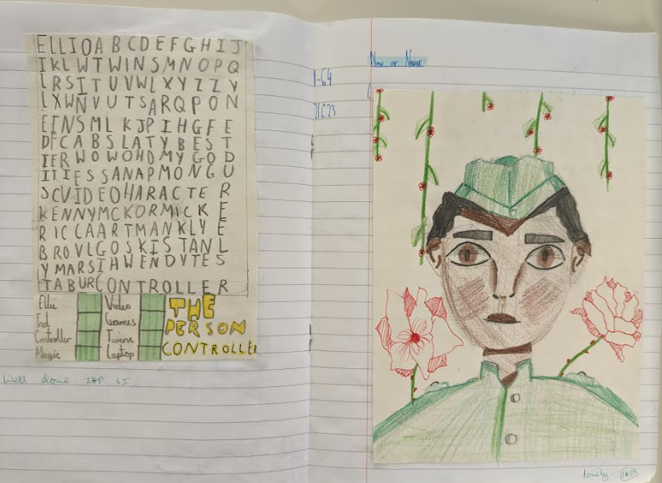

Slide 12
Click on the link below for the updated recommended reading book list for Y5 pupils. Happy reading! https://www.lovereading4schools.co.uk/lists
Check out this website https://www.thereaderteacher.com/ for some fantastic book recommendations for Year 5/6!

Slide 13
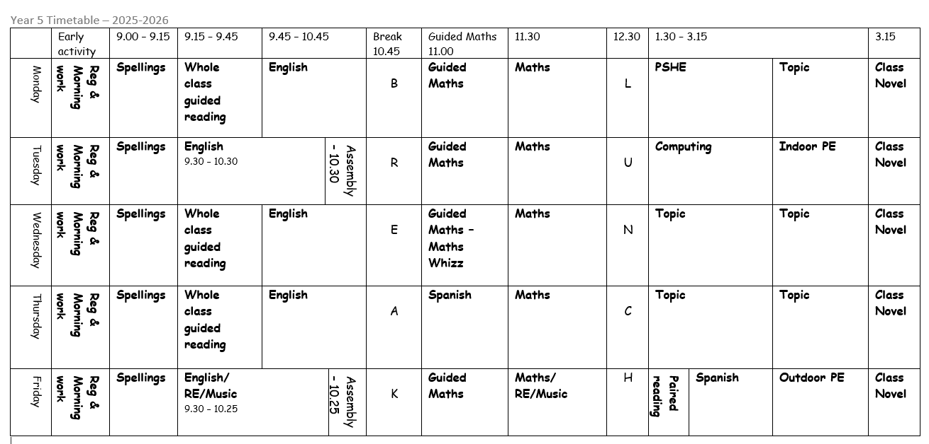

Slide 14

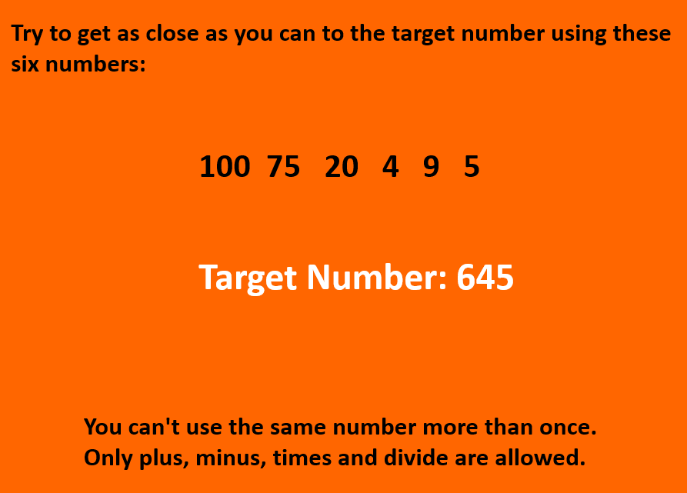
Morning work 8:45 a.m. – 9:00 a.m.

Slide 15
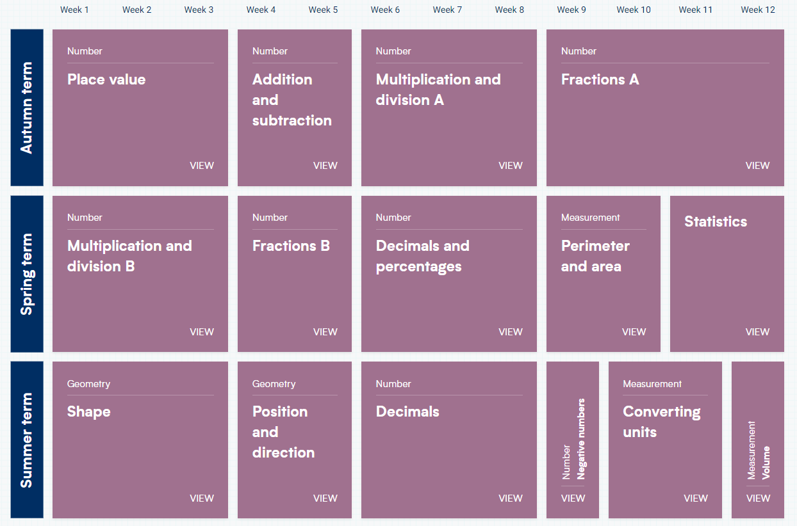
Maths
Cracking Times Tables – Every Tuesday
White Rose Maths

Slide 16

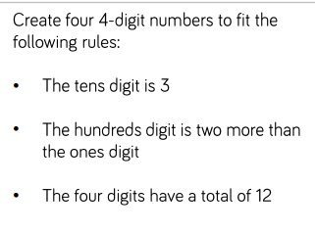
Reasoning and problem solving

Slide 17
Weekly News from Year 5
You’ll find a summary of our week in the school’s weekly newsletter
Please read this & discuss with your child
Good way to keep informed of current Y5 topics for possible days out etc.
Reminders are also on our news page

Slide 18



E-SAFETY
www.ceopeducation.co.uk
Keeping children safe online | NSPCC
Talk to your child about what apps they’re using and who they’re talking to
Take an interest and try to establish open communication to enable you to monitor what they’re doing online & help them understand that they can always talk to you if they are worried
Don’t rely 100% on Family Controls from your Internet Provider
Don’t allow your child to go to bed with their device/phone
Please don’t think “This will never happen to us or my child.” It does, it has and it will!

Slide 19


How to support your child at home
• Help your child get into a home-learning routine.
• Listen to them read when you can and read to them
• Have a dictionary and thesaurus in the home/online
• Practise times tables – NC expectation that they should know their times tables by end of Year 4.
• Maths in real life contexts – money, time, measuring (recipes etc.)
Ask them about their learning and well-being
Encourage them to talk to an adult in school if they feel uncomfortable about anything ASAP
Encourage them to further research a topic –Trips/books/museums
If you have knowledge/resources to share or know someone who we could invite into school to enrich our learning please let us know!

Slide 20

Communicating with me and the school
I’m normally dismissing the class at the end of the day – please do come and talk to me then if you can.
Alternatively, please e-mail the School Office who will forward any message to me
Please direct any medical appointment information directly to the School Office via e-mail wherever possible
If your child has received additional support in the past, this will continue as much as possible. Intervention groups may be set up according to pupil needs as they are identified
Mrs Heard, our School SENCo, will continue to work with pupils and parents where relevant and rest assured staff communicate regularly.
Please be assured I want the best for your child and will do whatever I can to help and support them

Slide 21


Thank you for listening – any questions?

