Slide 1
WELCOME TO YEAR 6
Mr Hasyn, Mrs Paterson, Mrs Hall, Mrs Grace

Slide 2
YEAR 6
• Preparing for secondary school
• Additional roles and responsibilities
- House/Vice Captains
- Lunchtime Duty
• High expectations – the oldest in the school, role models
Levels of effort – in class and home learning
Attendance
Punctuality – early morning learning activities

Slide 3
• Curriculum Maps – available on the school website
• Uniform & PE kit (Tuesday & Friday)
Please name your child’s uniform
Jewellery – basic wrist watch, studs if earrings worn (removed for swimming and PE days)
Long hair must be completely tied back with a simple hair band or plain scrunchie.
For hockey (spring 2) it is recommended that children wear shin pads and mouth guards.

Slide 4
Behaviour Policy & Expectations
Housepoints – given individually to reward behaviour, earn house points for their houses.
Class Marble Jar – marbles given to class to build up to class reward time.
Consequences
Yellow consequence – given a reminder
Orange consequence – miss 10 mins of break time, complete a reflection.
Red 1 – miss 15 mins of break time, complete a reflection.
Red 2 – miss 30 minutes of break, complete a reflection.
Red 3 – work away from class, internal exclusion with SLT.

Slide 5
Reflective Learning Time – Break & Lunchtime
Occasionally, pupils will be asked to rewrite or finish off work that they were expected to complete in a lesson.
This involves going to the Duty Teacher’s classroom and completing the work before going out to play/eat.

Slide 6


Home Learning
Maths home learning is set on a Thursday and is due for the following Thursday: 60 minutes of Maths Whizz (this includes in-school Maths ICT slot time)
Minimum of 4 Reading Journal entries (Date, book title, pages read and brief comment.) Parents/carers please sign at least once a week.
2 x high-quality Reading Journal Activities per half term
Journals should be in school EVERY DAY and will be formally checked on the day written on the Journal’s front cover.
If Maths or Reading home-learning tasks are not completed then your child will be required to complete them during reflective learning or during home learning club on Thursday lunch time.

Slide 7
Home Learning
There may be a creative project to complete linked to our Topic or Science lessons.
If any pupil has any problems completing or understanding the home learning tasks set they should come and speak to me as soon as possible
KS2 Home-learning club will be on Thursday lunchtimes

Slide 8
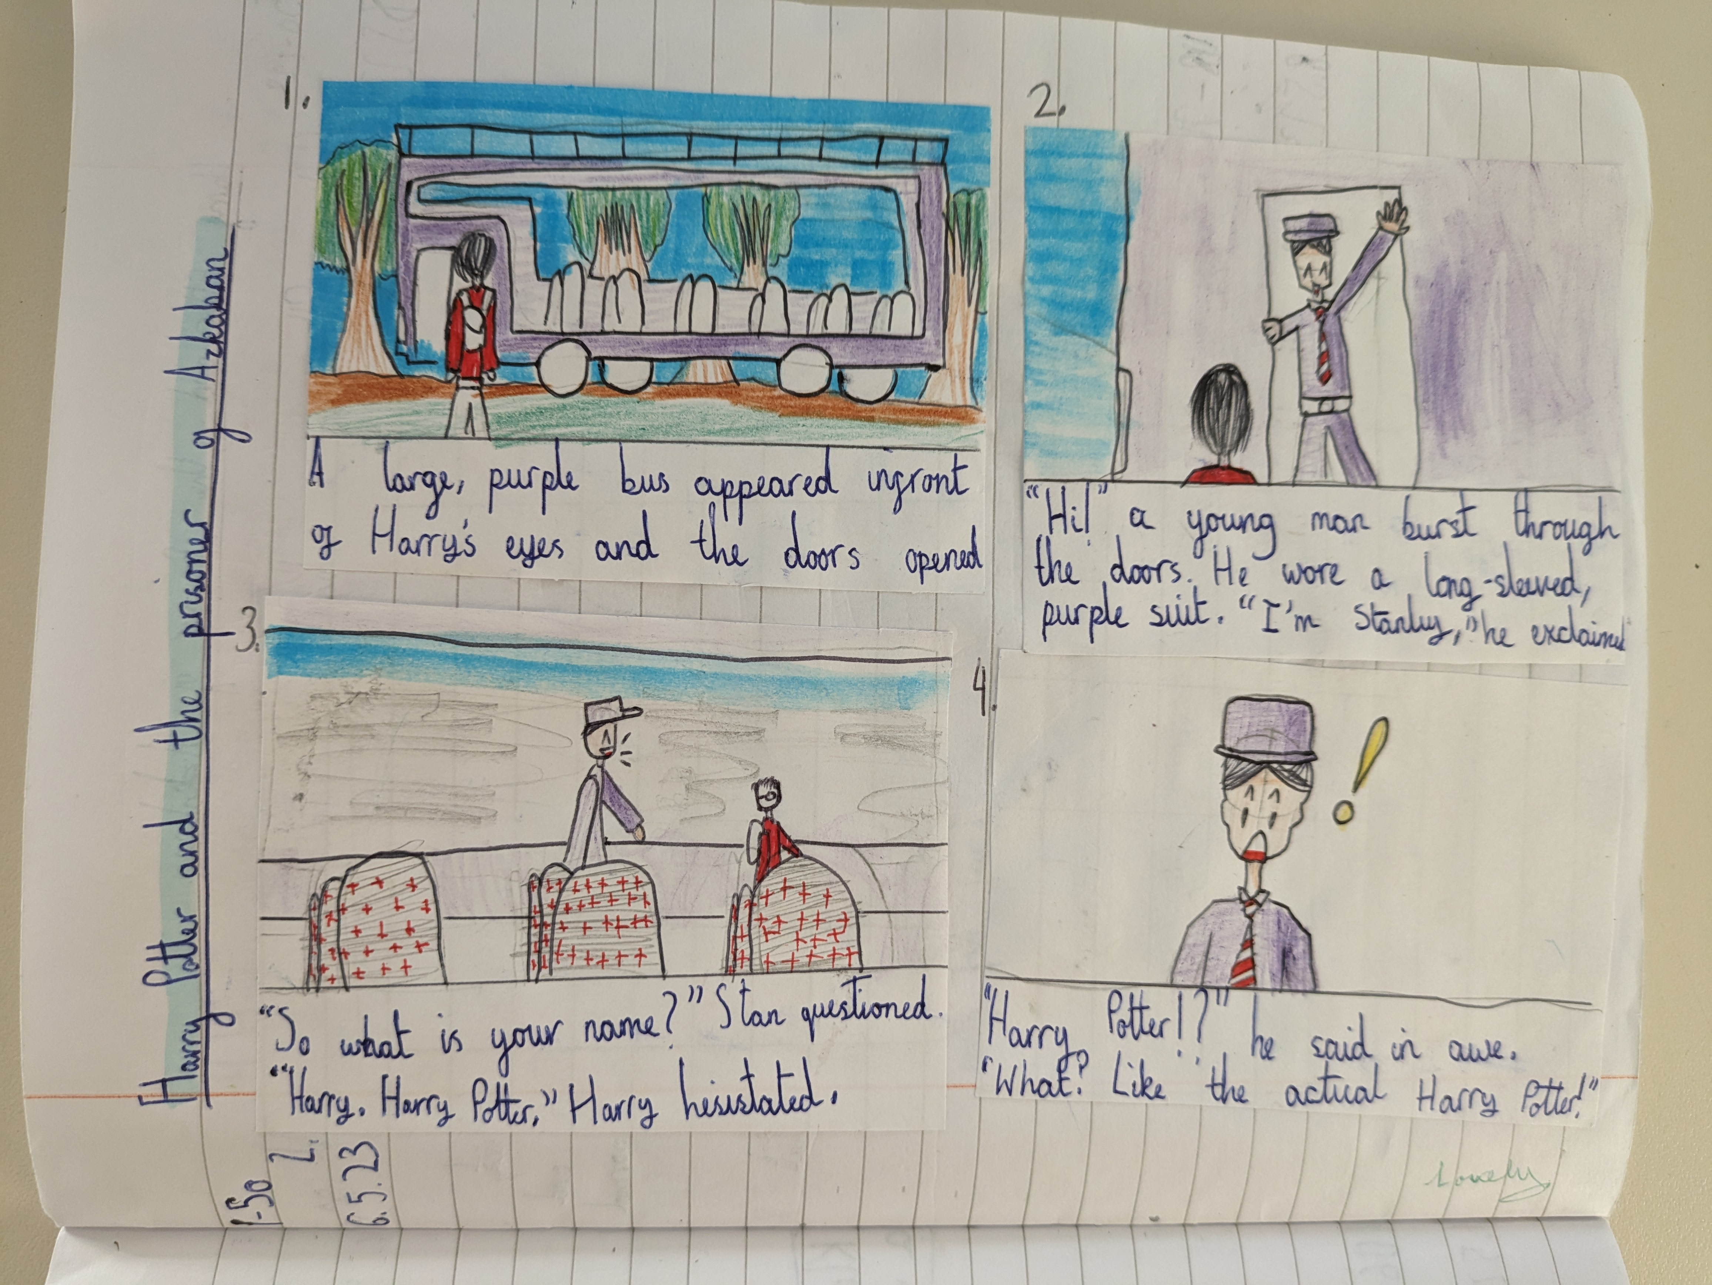
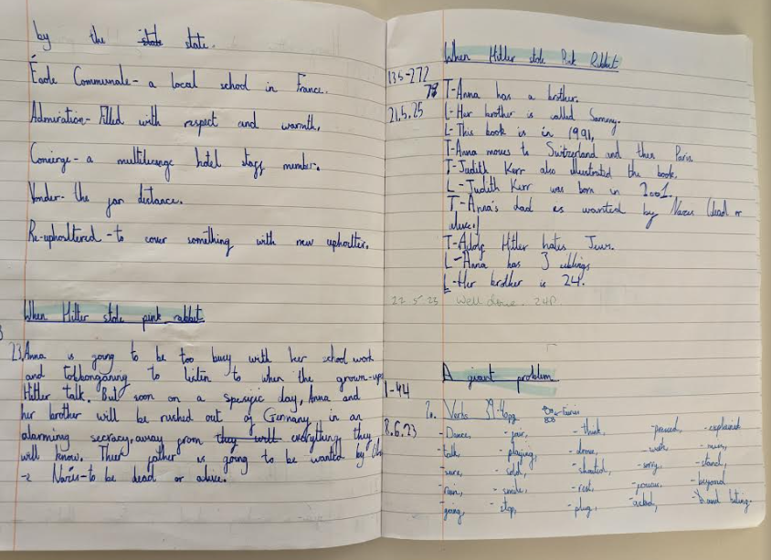
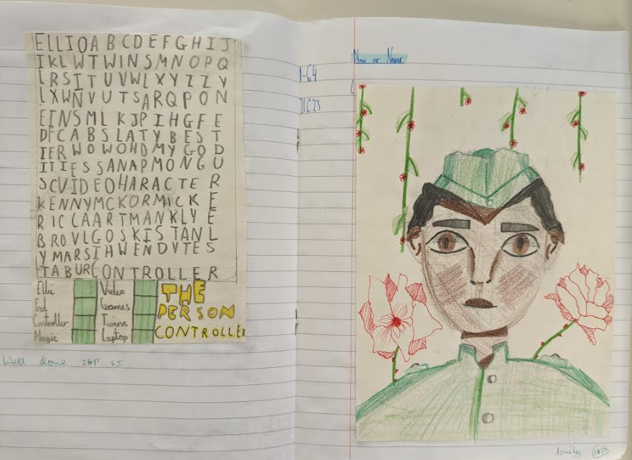
Reading Journal examples

Slide 9
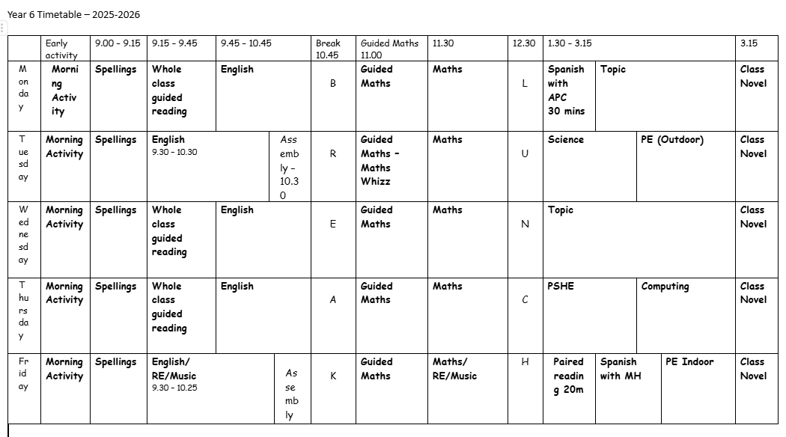

Slide 10
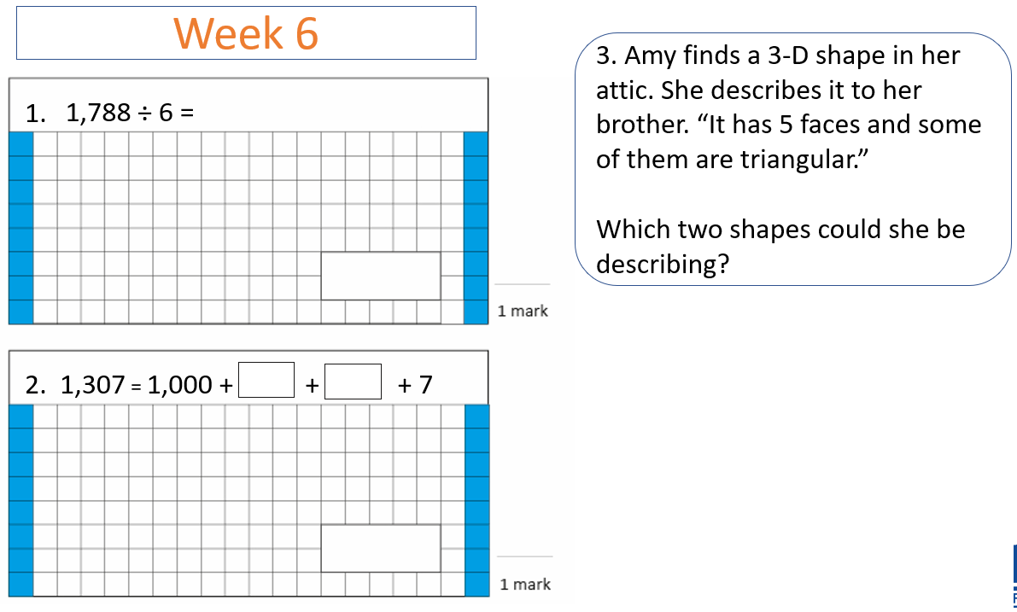
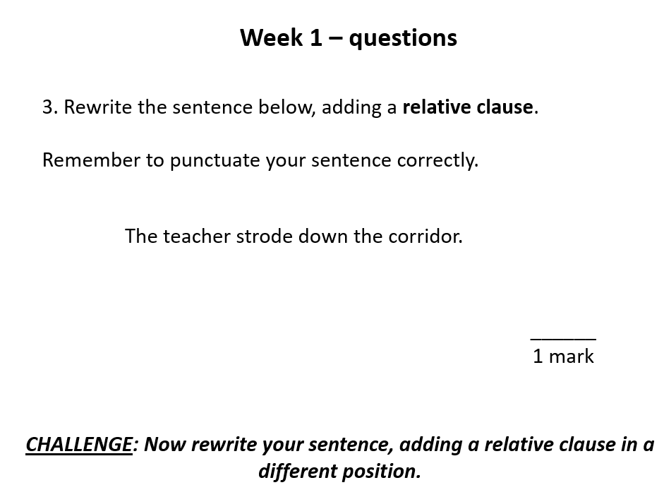
Morning work 8:45 a.m. – 9:00 a.m.

Slide 11
Diary dates
School Trips:
Thursday 16th October 2025 – Ashmolean Museum – Ancient Egyptians
Monday 18th May 2025 – Hazard Alley – PSHE/Safety
Assessment Weeks
Autumn 1: 15/09/25 - 19/09/25
Autumn 2: 10/11/25 - 14/11/25
Spring 1: 12/01/26 - 16/01/26
Spring 2: 02/03/26 - 06/03/26
SATS: 11/05/26 - 14/05/26

Slide 12


How to support your child at home
• Help your child get into a home-learning routine.
• Listen to them read when you can and read to them
• Have a dictionary and thesaurus in the home/online
• Practise times tables – NC expectation that they should know their times tables by end of Year 4.
• Maths in real life contexts – money, time, measuring (recipes etc.)
Ask them about their learning and well-being
Encourage them to talk to an adult in school if they feel uncomfortable about anything ASAP
Encourage them to further research a topic –Trips/books/museums

Slide 13


Thank you for listening – any questions?

