Slide 1
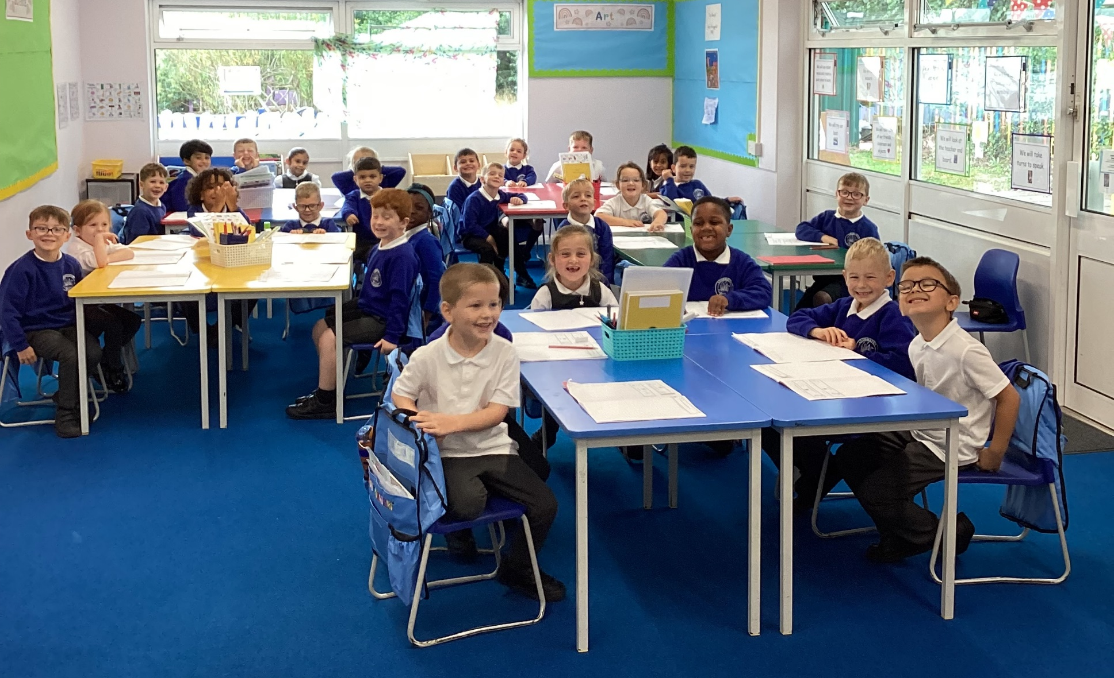
Welcome to Year 1!

Slide 2
Class teacher:
Mrs Olcot
Teaching Assistants:
Ms Iliffe (Mon-Fri all day), Mrs Lewis (Mon and Tues am) and Mrs Bampton (Weds, Thurs, Fri am)

Slide 3

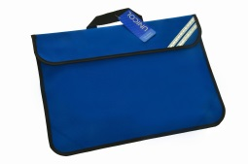
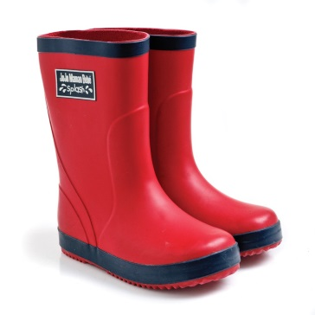
Expectations
Please ensure all items of clothing and footwear are named, including coats, hats, scarves and gloves!
Children need a bookbag only. Please do NOT send a rucksack to school. Please choose one keyring to attach to your bookbag – thank you!
Pupils need a pair of named wellies or outdoor shoe which can remain in school for the whole year.

Slide 4

Uniform – no cardigans. Sweatshirts with the school logo
School shoes on non-PE days – no trainers

Slide 5

Water bottle
Named water bottle everyday please. We encourage the children to drink water and the bottles can be refilled.

Slide 6

PE
PE days: Tuesday and Thursday
Indoor: Named house colour t-shirt with logo, black or navy shorts and named plimsolls.
Outdoor: Named house colour t-shirt with logo, black or navy tracksuit and named trainers (with a good grip)
All hair longer than your ears to be tied back.
All earrings to be removed on PE days. If earrings are still within the 6 week initial period please provide tape (dressing tape) to place over the earring.
All of the above is essential for the child’s health and safety.
PE is a compulsory part of the curriculum. We will endeavour to do PE twice a week as far as is possible. If your child is to be withdrawn from a PE session, a signed note from the parent or carer must be sent in to school. Anyone withdrawn from PE will be included in lesson time elsewhere in the school.

Slide 7

Reading
It is our expectation that pupils will read at home to an adult daily; at least 3 times per week as a minimum. These sessions must be recorded in the pupil’s Reading Diary.
I will check books on a Monday and Thursday.
The National Curriculum for Year 1 focuses on decoding and comprehension of texts.
Whole class guided reading

Slide 8
Home Learning
Reading is our main home learning task in Year 1, alongside practise of the high frequency words attached to the reading diary.
Reading Eggs – each week I will look at time on task, which will determine who receives the Reading Eggs award in Friday’s assembly.
Online Maths game/task – given to you via a link on the weekly newsletter.
If there is an activity linked to a topic we are learning, we will let you know about this via the newsletter.

Slide 9
Timetable
 | Early activity | 9.00 – 9.25 | 9.25 – 9.45 | 9.45 – 10.45 |  |  | Break 10.45 | Maths 11.00 | 12.00 | 12.30 | 1.30 – 3.15 (1.30-1.45 Reading) |  |  | 2.45-3.00 | 3.15
Monday | Reg & Morning work | Phonics | Guided reading | English |  |  | B | Maths | Maths | L | Science |  |  | Break | Storytime
Tuesday | Reg & Morning work | Phonics |  | English | Assembly – 10.30 |  | R | Maths | Maths | U | PE Indoors |  | PSHE | Break | Storytime
Wednesday | Reg & Morning work | Phonics | Guided reading | English |  |  | E | Maths | Maths | N | Computing |  | Topic | Break | Storytime
Thursday CK | Reg & Morning work | Phonics | Guided reading | English |  |  | A | Maths | Maths | C | PE Outdoors |  |  | Break | Storytime
Friday | Reg & Morning work | Phonics | RE/Music |  |  | Assembly – 10.25 | K | Topic | Topic | H | Paired reading | Continuous Provision – retrieval of skills and knowledge |  | Break | Storytime

Slide 10

Morning Activities
Morning activities begin at 8.45
Each morning has a different focus: Phonics, vocabulary, maths, topic and writing.
If children arrive after 8.45 they are missing the morning activity and, therefore, unable to benefit from the new learning or opportunity for revision that is so beneficial.

Slide 11
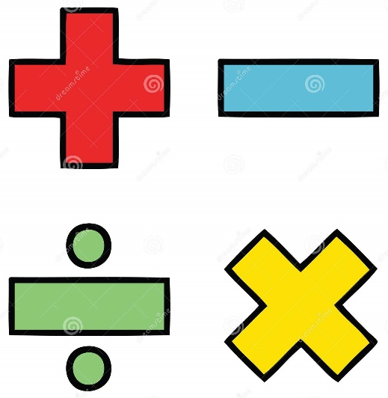
We are teaching the children new methods and strategies for addition and subtraction. If you would like further support with how to help your child at home with a particular method, please come and ask. I will be very happy to help!
Some of our PSHE topics can be quite sensitive e.g. discussion of body parts and e-safety.
A school focus is on Spoken Language. Please help your child to pronounce words clearly and accurately. This will give them a huge advantage when spelling. E.g. ‘then’ with a clear ‘th’, not a ‘v’ or ‘f’. Another example is to pronounce ‘twenty’ not ‘tweny’.
Writing – please see handout for sentence reminders.

Slide 12
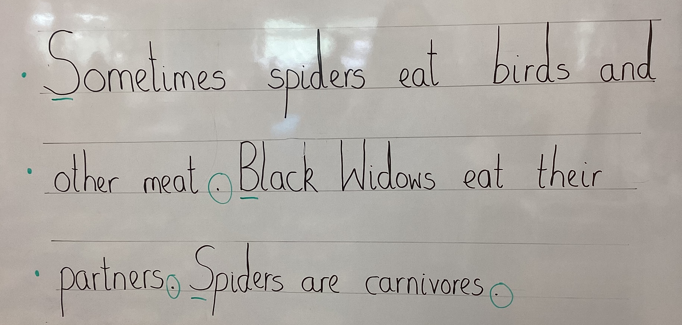

Slide 13

Expectations for behaviour are high, this includes behaviour for learning.
Class Charter has been agreed.
Behaviour – yellow consequences help to remind children of general expected classroom behaviours.
Rewards will be given for attention to these – praise, house points, marbles, stickers, golden time, agreed rewards.

Slide 14

Break time snacks – if provided from home please ensure they are fresh fruit snacks (not cereal bars/nuts).
End of day – please make yourself known by giving me a wave so I can ensure your child gets to you safely.
Polite reminder – if providing your child with birthday treats for the class, please ensure the products are nut free. Please do not be offended if we are unable to share the treat if we are not sure of their content.
E-safety – gaming and device use. Please check the recommended age guidance for online games.

Slide 15

Please feel free to come and speak to me at the end of the day if you have any questions, concerns or want to share something your child has achieved!
Many thanks for coming and I hope you have a lovely Year 1 experience.

