Slide 1
Welcome to Year 2!

Slide 2
Class teacher:
Mr Parsons
Teaching Assistants:
Mrs Nicholls and Mrs Whitmore

Slide 3

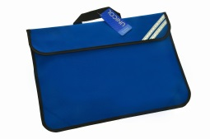
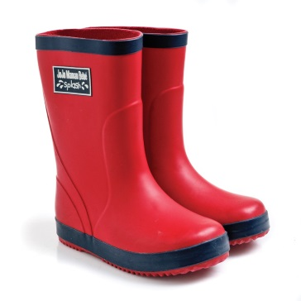
Expectations
Please ensure all items of clothing and footwear are named, including coats, hats, scarves and gloves!
Children need a bookbag only. Please do NOT send a rucksack to school. Please choose one keyring to attach to your bookbag.
Pupils need a pair of named wellies or outdoor shoe which can remain in school for the whole year.

Slide 4
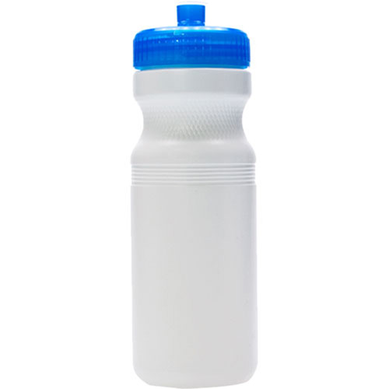
Water bottle
Please ensure children bring a named water bottle every day. We encourage the children to drink water, which can be refilled at the tap.

Slide 5

PE
PE days: Monday and Thursday
Indoor: Named house colour t-shirt with logo, black or navy shorts and named plimsolls.
Outdoor: Named house colour t-shirt with logo, black or navy tracksuit and named trainers (with a good grip)
All hair longer than your ears to be tied back.
All earrings to be removed on PE days. If earrings are still within the 6 week initial period please provide tape (dressing tape) to place over the earring.
PE is a compulsory part of the curriculum. We will endeavour to do PE twice a week as far as is possible. If your child is to be withdrawn from a PE session, a signed note from the parent or carer must be sent in to school. Anyone withdrawn from PE will be included in lesson time elsewhere in the school.

Slide 6

Reading
It is our expectation that pupils will read at home to an adult daily; at least 4 times per week as a minimum. These sessions must be recorded in the pupil’s Reading Diary.
I will check books on a Monday and Thursday.
The National Curriculum for Year 2 focuses heavily on comprehension of texts.
Whole class guided reading

Slide 7
Home Learning
Reading is our main home learning task in Year 2, alongside practise of the high frequency words attached to the reading diary.
Reading Eggs – each week I will look at time on task, which will determine who receives the Reading Eggs award in Friday’s assembly.

Slide 8
Timetable
Mon | Morning Activities & Registration | Phonics | Guided Reading | English |  |  | Playtime | Maths | Lunch | Outdoor PE |  | Library | Library | Story
Tues |  | Phonics | English |  |  | Assembly |  | Maths |  | Topic |  |  |  | Story
Wed |  | Phonics | Guided Reading | English |  |  |  | Maths |  | PSHE | Computing |  |  | Story
Thurs Mr Williams |  | Phonics | Guided Reading | RE/Music |  |  |  | Maths |  | Indoor PE |  |  |  | Story
Fri |  | Phonics | English |  | Ach Assembly |  |  | Topic |  | Paired Reading | Science |  |  | Story

Slide 9
Morning Activities
Morning activities begin at 8.45
On a Monday, Tuesday and Thursday we will be focusing on handwriting. On a Wednesday we will be doing some Maths retrieval with Pobble on a Friday.
If children arrive after 8.45 they are missing the morning activity and, therefore, unable to benefit from the new learning or opportunity for revision that is so beneficial.

Slide 10
And finally …
If you would like any support with how to help your child at home with a particular subject or method, please come and ask. I will be very happy to help!
Some of our PSHE topics can be quite sensitive e.g. discussion of loss, e-safety and relationships. We will let you know before teaching any topic we think may be sensitive.
A school focus is on Spoken Language. Please help your child to pronounce words clearly and accurately. This will give them a huge advantage when spelling.

Slide 11
Expectations for behaviour are high, this includes behaviour for learning.
We as class have agreed on our Class Charter.
Rewards will be given for attention to these – praise, house points, marbles, stickers, golden time, agreed rewards.
Sanctions for low level behaviours will be given when classroom behaviour is below expectation in the form of yellow consequences – which Mr Spratt will explain more of.
Break time snacks – if provided from home please ensure they are fresh fruit snacks (not cereal bars/nuts).
Polite reminder – if providing your child with birthday treats for the class, please ensure the products are nut free. Please do not be offended if we are unable to share the treat if we are not sure of their content.

Slide 12
If you have a message for me, then please pass the message to the person on gate duty or phone the office and it will get passed on to myself.
Or feel free to come and find me at the end of each day.

