Slide 1
WELCOME TO YEAR 3
Miss Hill
Mrs King– Class Teaching Assistant

Slide 2

Behaviour Policy & Expectations
High expectations – behaviour for learning, levels of effort, attendance & punctuality.
New system of behaviour sanctions.
Yellow warning – low level disruptions = Reminder to change behaviour, name on the board
Orange – increase in level of disruption or repetition of yellow behaviour – 10 minutes of break missed – reflection sheet completed
Red 1, 2 & 3 – more serious behaviour – 15 or 30 minutes of break or lunch missed or possible exclusion – reflection sheet completed.

Slide 3
REMINDERS
• Curriculum Maps
• Uniform & PE kit (Wednesday & Friday, after swimming finishes)
Please, please, please name your child’s uniform
Help from school if needed
Jewellery – basic wrist watch, studs if earrings worn (removed for swimming, removed or taped on PE days)
Long hair must be completely tied back with a simple hair band or plain scrunchie – head lice!

Slide 4
• No nuts please – lunch boxes & birthday sweets (halal).
• Break time snack – fruit or veg
• Presentation will be available on the school website

Slide 5
Reflective Learning Time – Lunchtime
Occasionally, pupils will be asked to rewrite or finish off work that they were expected to complete in a lesson.
This involves going to the Duty Teacher’s classroom and completing the work before going out to play/eat.

Slide 6


Home Learning
At least 30 minutes of Times Table Rock Stars each week. This will be checked every Thursday morning. If the required amount of time is not completed, then it will be completed on Thursday lunchtime.
Reading – School reading book - Minimum of 4 entries on the Reading Log Bookmark each week (Date, book title, pages read.) Parents/carers please initial each time. Reading books and bookmarks should be in school everyday but are checked every Friday.
Reading Journals (purple book) At least 2 x good quality Reading Journal activities to be completed over half a term. This can be from any book that they are reading.
Reading Journals should be in school every Friday.

Slide 7

Reading Journals – Purple A5 books
• Regular reading is crucial to improving both fluency and comprehension
• Reading is a vital part of becoming a better writer
• Quality of reading books
• Selection of activities to complete in the first pages.

Slide 8
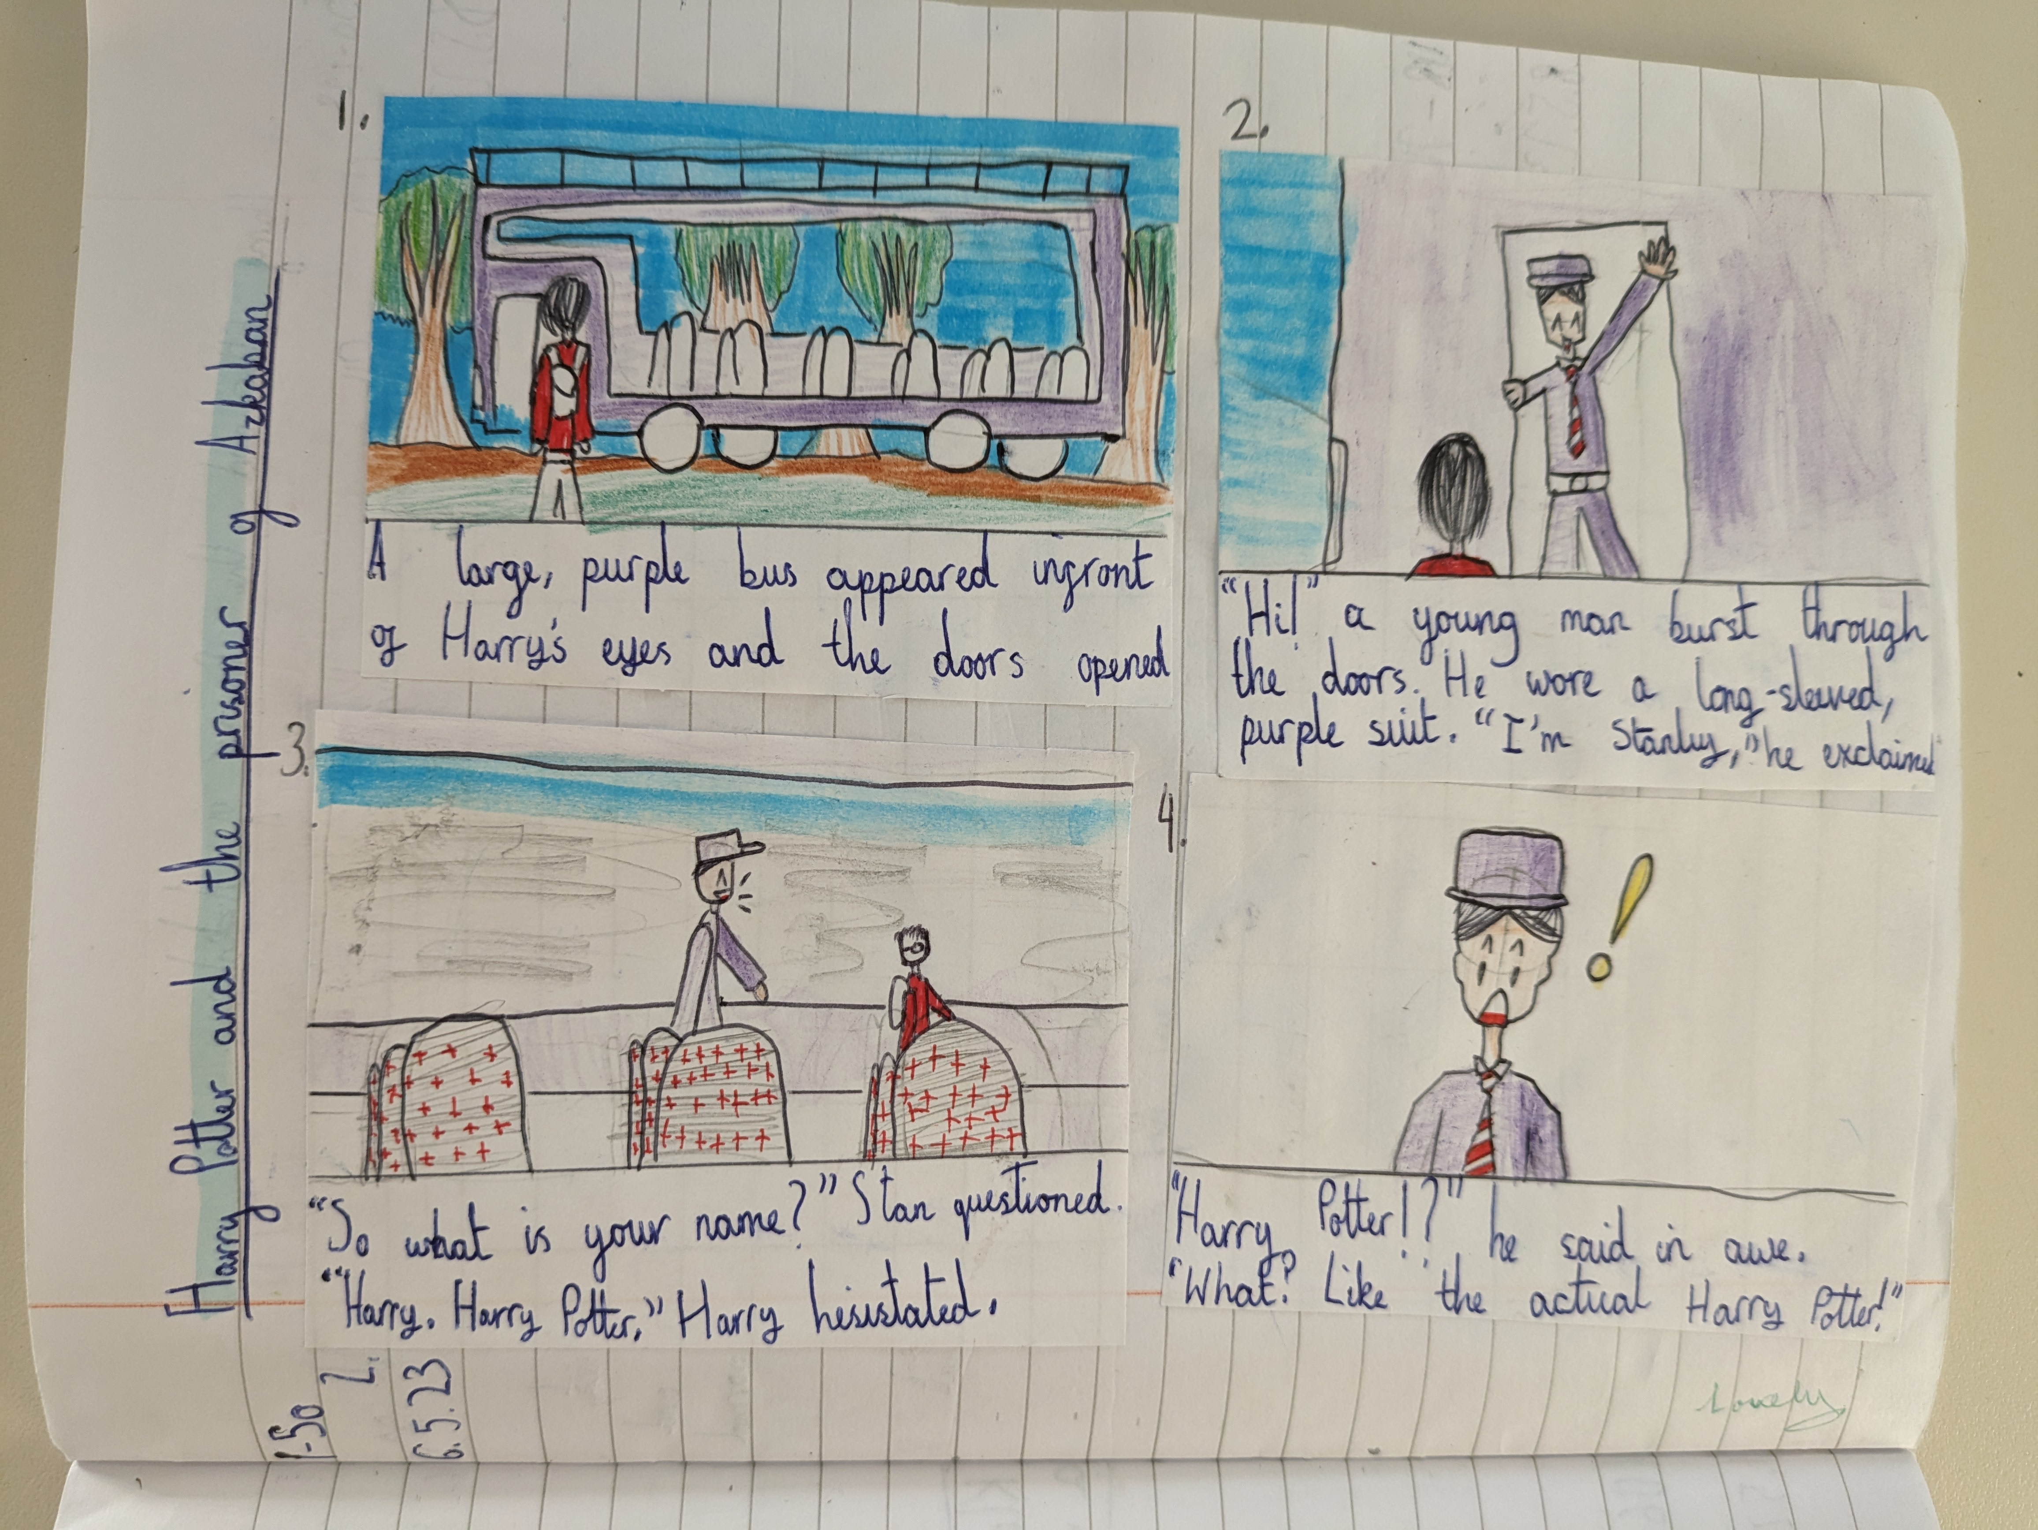

Slide 9
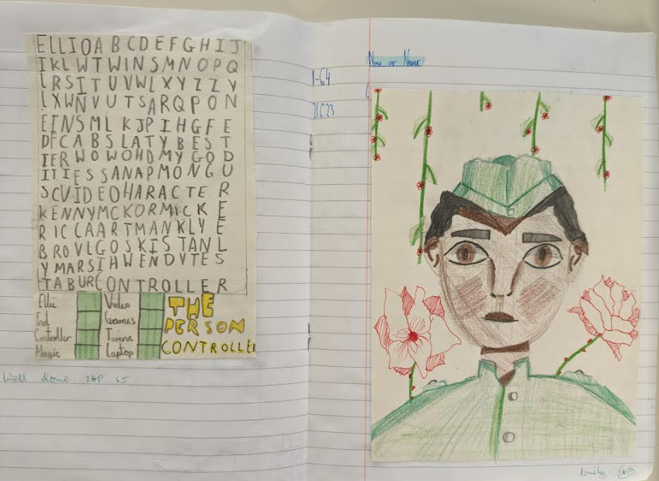

Slide 10
Click on the link below for the updated recommended reading book list for Y3 pupils.
https://www.booksfortopics.com/booklists/recommended-reads/year-3/
Check out this website
https://www.thereaderteacher.com/year3
for some fantastic book recommendations for Year 3!

Slide 11
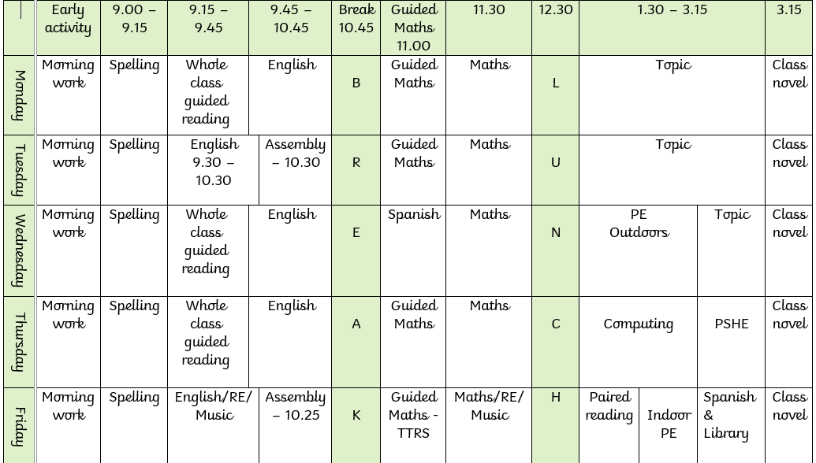

Slide 12
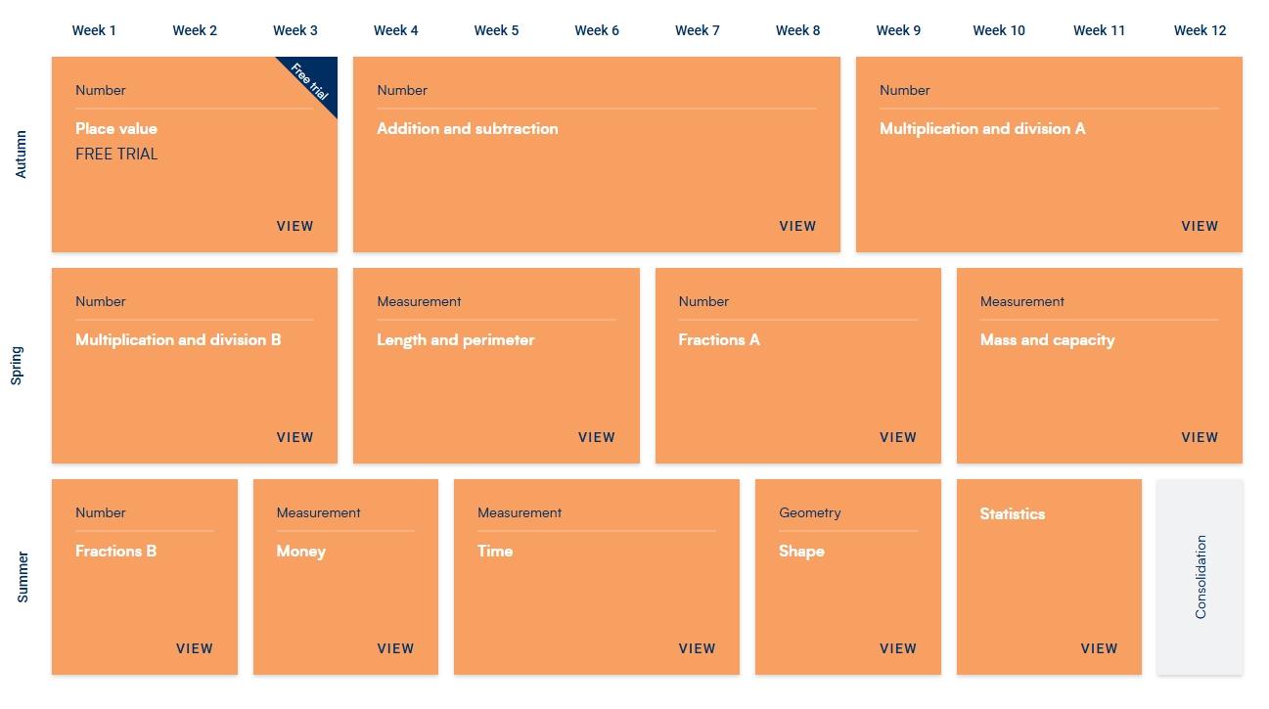
Maths
Cracking Times Tables – Every Tuesday
White Rose Maths

Slide 13



E-SAFETY
www.ceopeducation.co.uk
Keeping children safe online | NSPCC
Talk to your child about what apps they’re using and who they’re talking to
Take an interest and try to establish open communication to enable you to monitor what they’re doing online & help them understand that they can always talk to you if they are worried
Don’t rely 100% on Family Controls from your Internet Provider
Don’t allow your child to go to bed with their device/phone
Please don’t think “This will never happen to us or my child.” It does, it has and it will!

Slide 14


How to support your child at home
• Help your child get into a home-learning routine.
• Listen to them read when you can and read to them
• Have a dictionary and thesaurus in the home/online
• Practise times tables – NC expectation that they should know their times tables up to 12 x 12 by end of Year 4.
• Maths in real life contexts – money, time, measuring (recipes etc.)
Ask them about their learning and well-being
Encourage them to talk to an adult in school if they feel uncomfortable about anything ASAP
Encourage them to further research a topic –Trips/books/museums
If you have knowledge/resources to share or know someone who we could invite into school to enrich our learning please let us know!

Slide 15
Best way to communicate with class teacher
● email the office for teacher’s attention
● responses to emails will only be made during working hours and replied to within 24 hours where possible
● urgent – phone the office
● speak to class teacher at the end of the day
● If you need to speak to the class teacher before school, please call into the school office first

Slide 16


Thank you for listening – any questions?

